Slide 1


Adarsh Institute of Technology &
Research Centre, Vita
Department of Computer Science & Engineering
Class-TY
Mini project Presentation on:
“Course Resource Hub”
Team members :
Mr. Pranav Prabhakar Mandale (CS3011)
Mr. Suraj Appa Bansode (CS3012)
Mr. Saurabh Sadashiv Mali. (CS3013)
Mr. Vighnesh Mashnu Pawar. (CS3014)
Academic Year
2023-2024
Under Guidance of:
Asst.Prof. Miss. S. L. Jadhav

Slide 2
INDEX
Introduction
Literature Survey
Existing System
Proposed System
Requirement Analysis
System Design
User Interface
Future Scope
Conclusion
References

Slide 3
INTRODUCTION
In today's time, there's a big need for study materials that are easy to get and of good quality for college students.
So we are making a website that all students can get study material.
Students can download Previous Year Question papers, textbooks, mid-sem question papers at one place.

Slide 4
Literature Survey
Sr.no | Title of Paper | Author | Year | Advantages
1. | Enhancing E-Learning | K.Swasha | 2023 | College notes websites often provide well-structured note collections. These websites can host notes contributed by students from around the world.

Slide 5
Sr.no | Title of Paper | Author | Year | Advantages
2. | Innovative Learning | M. Maheswari. | 2021 | Collaboration tools for students to share and discuss notes. Students can choose notes that align with their learning style.
3. | Empowering Education | S.Steffie Gracia. | 2020 | Efficient sharing and access to college notes. User-friendly interface for students from all disciplines.
.

Slide 6
Existing System
The existing system of the college notes website includes features such as user registration, login, and access to course-specific notes.
Users can upload, download, and comment on notes.
The overall design focuses on facilitating the sharing and retrieval of academic materials among students.
All study material not available in one platform.
In this System there is more chance of distraction.

Slide 7
Proposed System
The proposed project is to create a user-friendly website Personalized to the needs of college students.
This website will serve as a comprehensive repository of study materials.
The project's main objective is to offer students efficient access to crucial study resources for academic success.
One platform for all study material.
Our website provide notes, previous year question paper, soft copy of text book to students.

Slide 8
Requirement Analysis
HARDWARE REQUIREMENT:
• RAM - 4GB.
• Space - 256GB.
• CPU - 2GHz or faster.
• Architecture - 32-bit or 64-bit.
SOFTWARE REQUIREMENT:
• Operating System - Windows 10 or Above.
• Languages - HTML,CSS,Javascript,Bootstrap.
• IDE - Visual Studio code.

Slide 9
System Design
Web services
Home
Resources
Free Courses
Library
Review
First Year
Second Year
Third Year
Fourth Year
Notes
Previous Year Question papers
Video Links
Textbooks

Slide 10
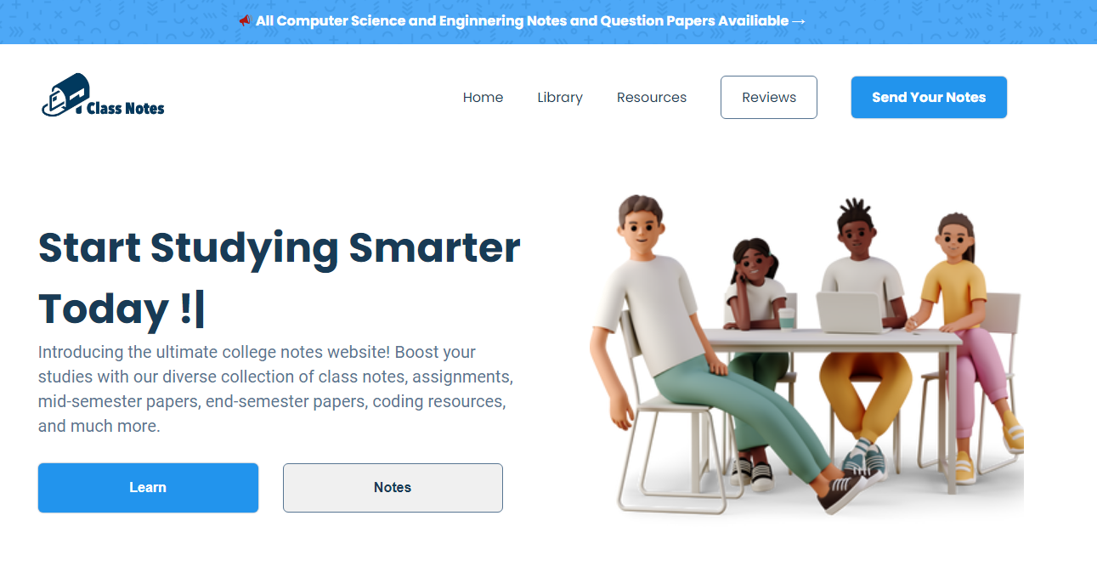
User Interface
Screenshot 1 : Home

Slide 11
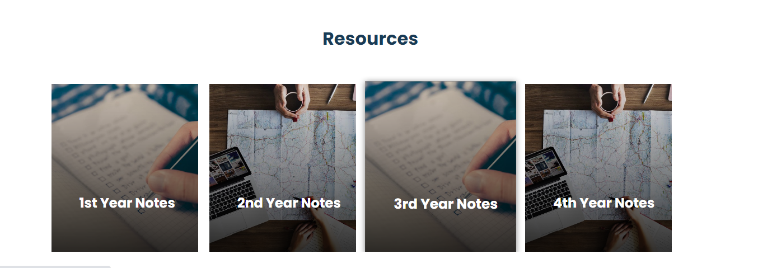
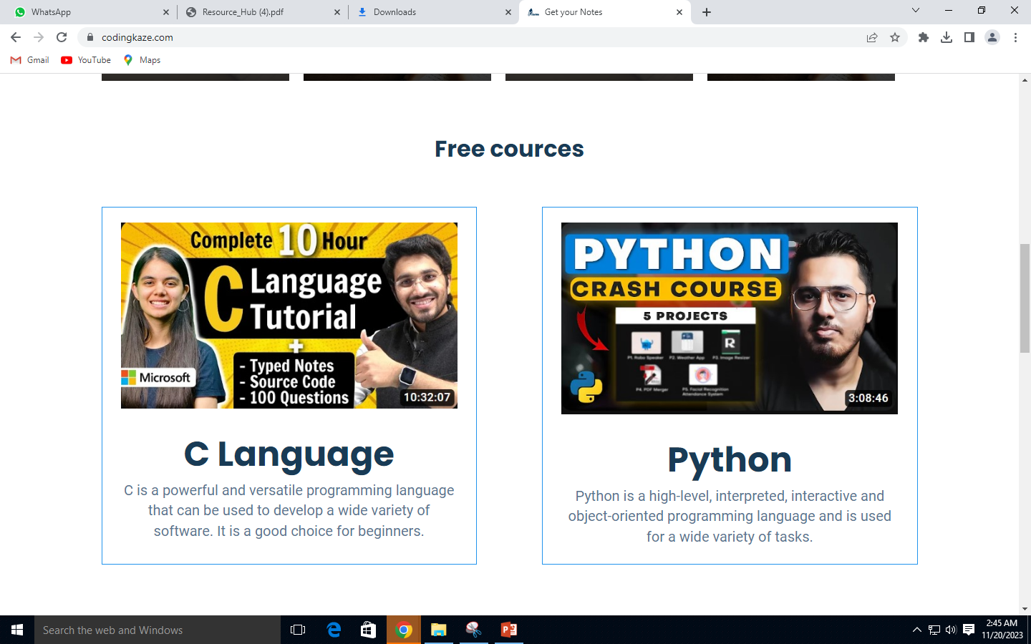
Screenshot 2 : Resources

Slide 12
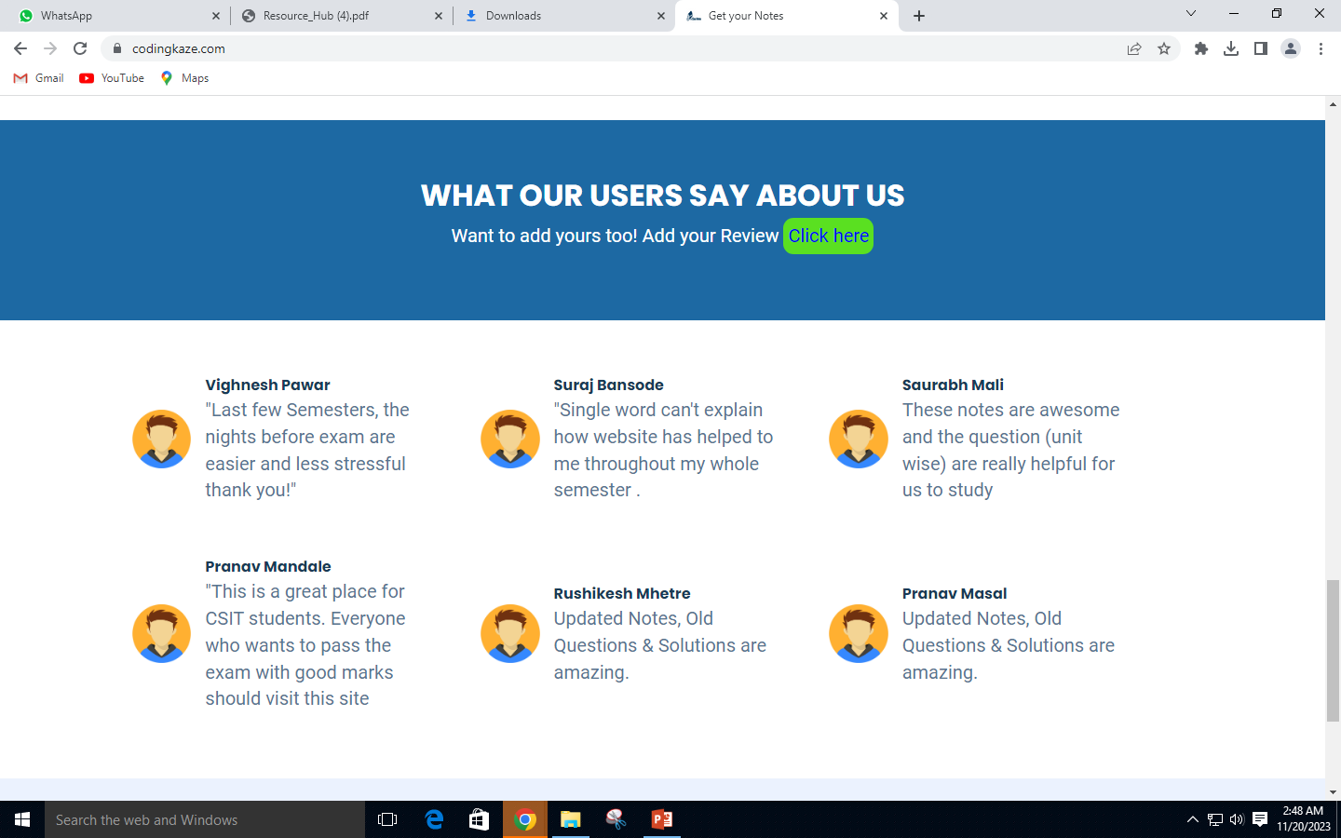
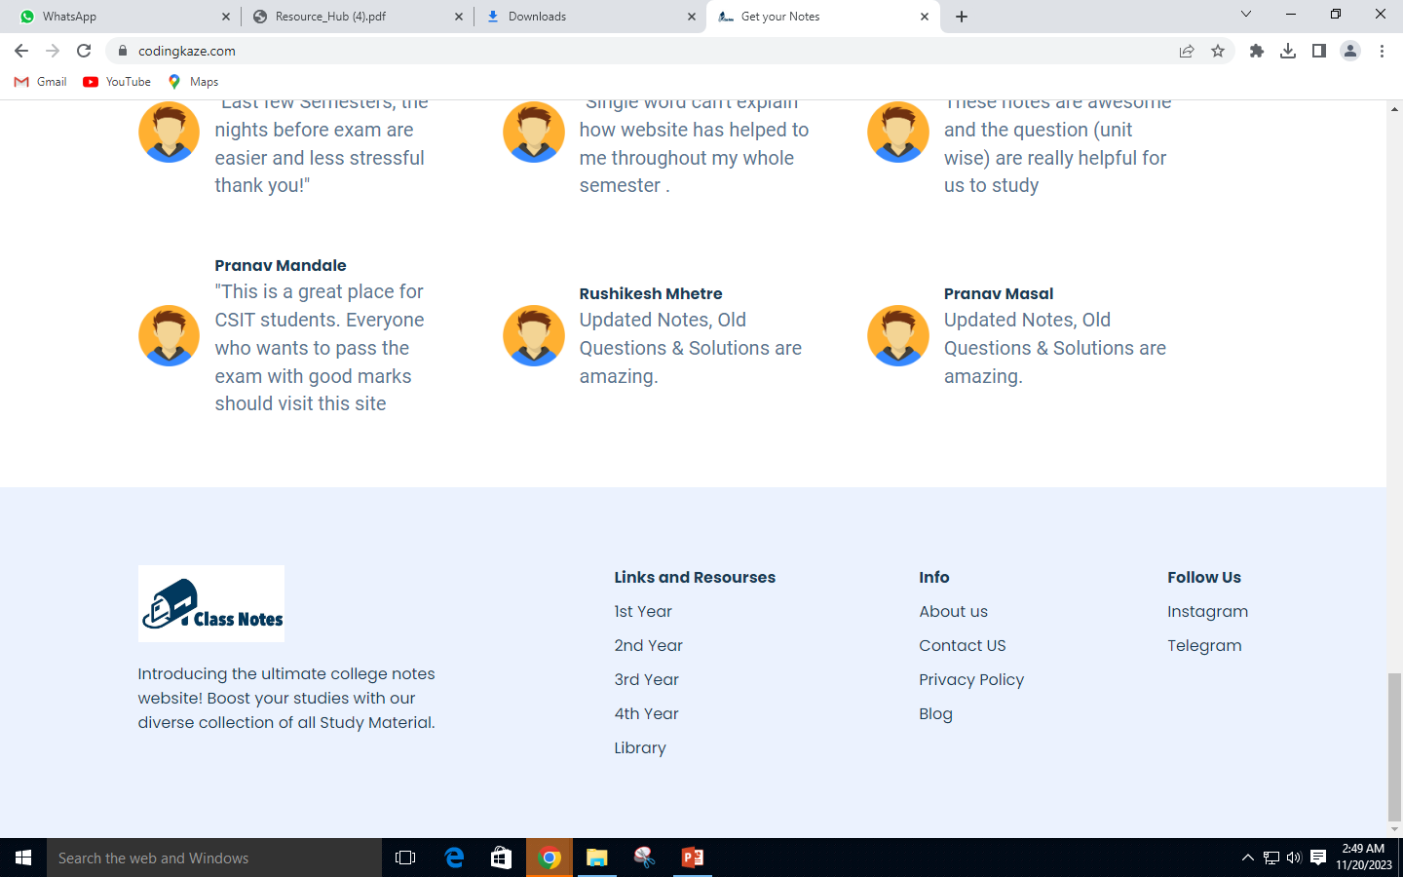
Screenshot 3 : Feedback

Slide 13
Future Scope
Enhanced Search Functionality.
Responsive Design.
Content Categorization and Tagging.
Regular Updates.
User Feedback Mechanism.

Slide 14
Conclusion
Centralized Resource Hub.
Syllabus Repository.
Library Section for Reference Materials.
Diverse Learning Resources.
User Feedback Integration.
User Contribution Feature.

Slide 15
References
https://ieeexplore.ieee.org/document/10142801
https://sktperfectdemo.com/themepack/elearning/
https://dribbble.com/shots/20358147-E-Learning-Website
https://telegram.me/dbatu_notes_bot
https://www.w3schools.com/

Slide 16
THANK YOU

